Slide 1
Nordwind company

Slide 2
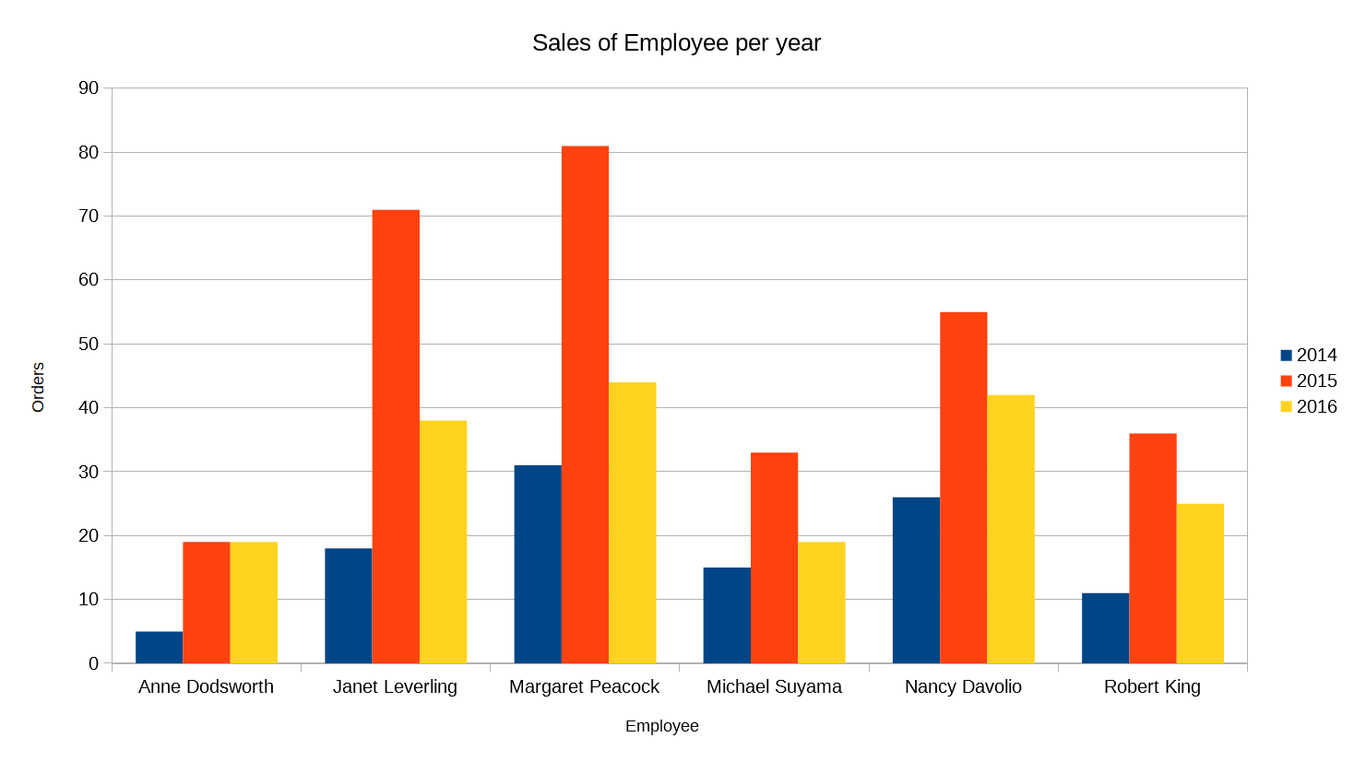
Yearly sales of our employees
This visualization displays on the X axis a list of the employees, and the Y axis shows the number of orders."
As you can see: 2015 was the best year and Margaret and Janet are the best employees.
Notes:
<SQL query>

Slide 3
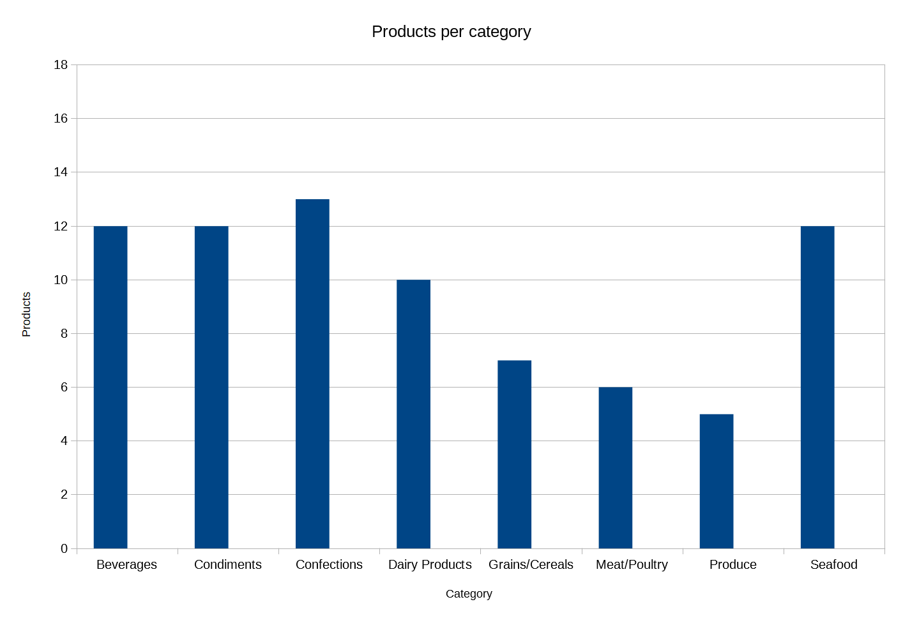
Most products per category
This visualization displays on the X axis a list of categories, and the Y axis shows the number of products for each categories".
As you may notice we should discuss why we have only 5 products in the category “Produce”.
Notes:
<SQL query>

Slide 4
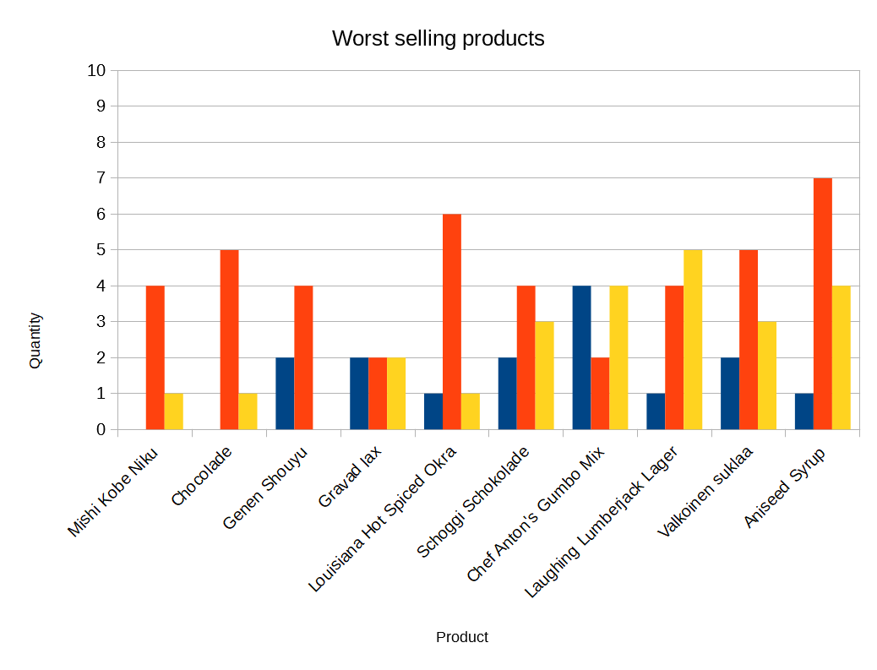
Top ten worst selling products
This visualization displays on the X axis a list of products, and the Y axis shows the number of orders for each product over the last three years.
Also here we should rethink our product portfolio. Should we really offer Okra for example?
Notes:
<SQL query>

Slide 5
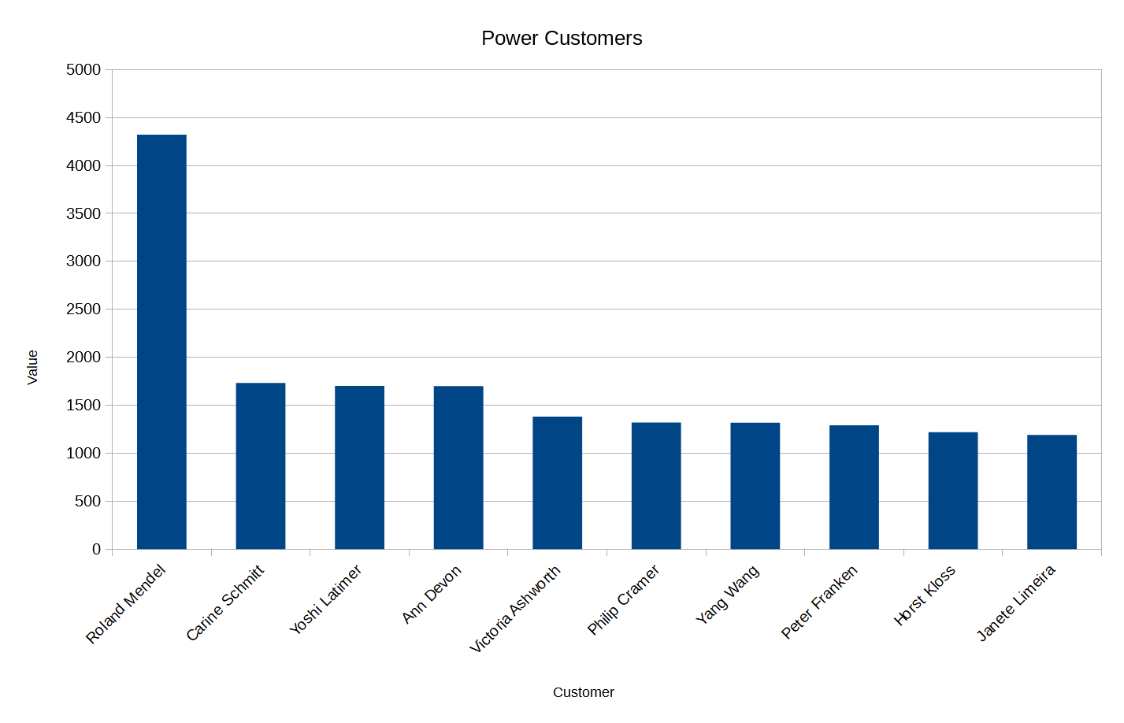
Power customers with the most revenue
This visualization displays on the X axis a list of customers, and the Y axis shows the order value of each customer.
We should beware of the risk: losing Roland Mendel. He is our power customer.
Notes:
<SQL query>

Slide 6
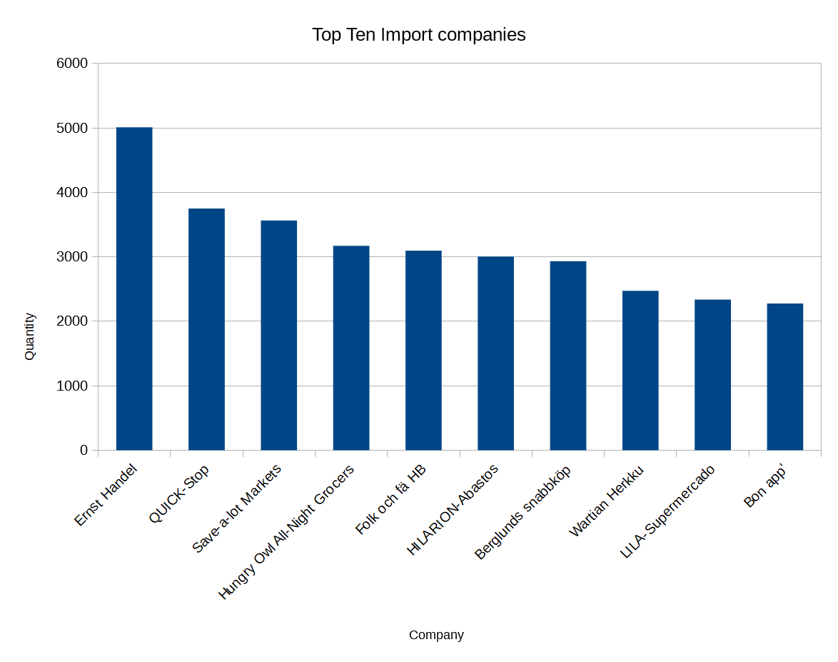
Top ten companies with imports
This visualization displays on the X axis a list of companies, and the Y axis shows the number of orders for each product. The companies imports the products from foreign countries.
Maybe we should look for a local distributor? For a better service, for making the delivering process faster.
Notes:
<SQL query>

